Slide 1
Trace a Program Execution
animation
allocate memory for radius
public class ComputeArea {
/** Main method */
public static void main(String[] args) {
double radius;
double area;
// Assign a radius
radius = 20;
// Compute area
area = radius * radius * 3.14159;
// Display results
System.out.println("The area for the circle of radius " +
radius + " is " + area);
}
}
radius
no value

Slide 2
Trace a Program Execution
animation
public class ComputeArea {
/** Main method */
public static void main(String[] args) {
double radius;
double area;
// Assign a radius
radius = 20;
// Compute area
area = radius * radius * 3.14159;
// Display results
System.out.println("The area for the circle of radius " +
radius + " is " + area);
}
}
memory
radius
no value
area
no value
allocate memory for area

Slide 3
Trace a Program Execution
animation
public class ComputeArea {
/** Main method */
public static void main(String[] args) {
double radius;
double area;
// Assign a radius
radius = 20;
// Compute area
area = radius * radius * 3.14159;
// Display results
System.out.println("The area for the circle of radius " +
radius + " is " + area);
}
}
assign 20 to radius
radius
20
area
no value

Slide 4
Trace a Program Execution
animation
public class ComputeArea {
/** Main method */
public static void main(String[] args) {
double radius;
double area;
// Assign a radius
radius = 20;
// Compute area
area = radius * radius * 3.14159;
// Display results
System.out.println("The area for the circle of radius " +
radius + " is " + area);
}
}
memory
radius
20
area
1256.636
compute area and assign it to variable area

Slide 5

Trace a Program Execution
animation
public class ComputeArea {
/** Main method */
public static void main(String[] args) {
double radius;
double area;
// Assign a radius
radius = 20;
// Compute area
area = radius * radius * 3.14159;
// Display results
System.out.println("The area for the circle of radius " +
radius + " is " + area);
}
}
memory
radius
20
area
1256.636
print a message to the console

Slide 6
Reading Input from the Console
1. Create a Scanner object
  Scanner input = new Scanner(System.in);
2. Use the method nextDouble() to obtain to a double value. For example,
  System.out.print("Enter a double value: ");
  Scanner input = new Scanner(System.in);
  double d = input.nextDouble();

Slide 7
Identifiers
An identifier is a sequence of characters that consist of letters, digits, underscores (_), and dollar signs ($).
An identifier must start with a letter, an underscore (_), or a dollar sign ($). It cannot start with a digit.
An identifier cannot be a reserved word. (See Appendix A, “Java Keywords,” for a list of reserved words).
An identifier cannot be true, false, or
null.
An identifier can be of any length.

Slide 8
Variables
// Compute the first area
radius = 1.0;
area = radius * radius * 3.14159;
System.out.println("The area is “ + area + " for radius "+radius);
// Compute the second area
radius = 2.0;
area = radius * radius * 3.14159;
System.out.println("The area is “ + area + " for radius "+radius);

Slide 9
Declaring Variables
int x; // Declare x to be an
// integer variable;
double radius; // Declare radius to
// be a double variable;
char a; // Declare a to be a
// character variable;

Slide 10
Assignment Statements
x = 1; // Assign 1 to x;
radius = 1.0; // Assign 1.0 to radius;
a = 'A'; // Assign 'A' to a;

Slide 11
Declaring and Initializing in One Step
int x = 1;
double d = 1.4;

Slide 12
Named Constants
final datatype CONSTANTNAME = VALUE;
final double PI = 3.14159;
final int SIZE = 3;

Slide 13
Naming Conventions
Choose meaningful and descriptive names.
Variables and method names:
  Use lowercase. If the name consists of several words, concatenate all in one, use lowercase for the first word, and capitalize the first letter of each subsequent word in the name. For example, the variables radius and area, and the method computeArea.

Slide 14
Naming Conventions, cont.
Class names:
  Capitalize the first letter of each word in the name. For example, the class name ComputeArea.
Constants:
  Capitalize all letters in constants, and use underscores to connect words. For example, the constant PI and MAX_VALUE

Slide 15

Numerical Data Types

Slide 16
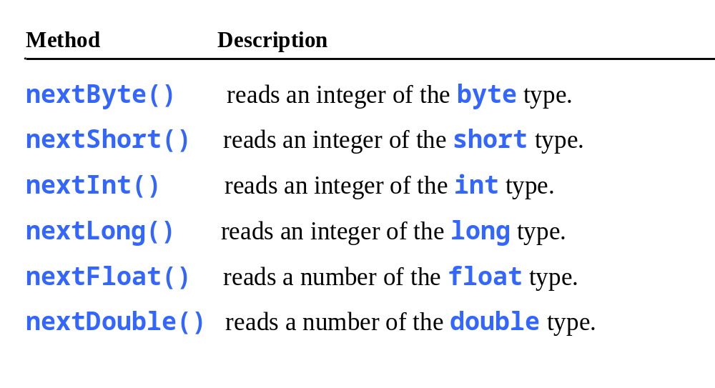
Reading Numbers from the Keyboard
Scanner input = new Scanner(System.in);
int value = input.nextInt();

Slide 17

Numeric Operators

Slide 18
Integer Division
+, -, *, /, and %
5 / 2 yields an integer 2.
5.0 / 2 yields a double value 2.5
5 % 2 yields 1 (the remainder of the division)

Slide 19

Remainder Operator
Remainder is very useful in programming. For example, an even number % 2 is always 0 and an odd number % 2 is always 1. So you can use this property to determine whether a number is even or odd. Suppose today is Saturday and you and your friends are going to meet in 10 days. What day is in 10 days? You can find that day is Tuesday using the following expression:

Slide 20
Exponent Operations
System.out.println(Math.pow(2, 3));
// Displays 8.0
System.out.println(Math.pow(4, 0.5));
// Displays 2.0
System.out.println(Math.pow(2.5, 2));
// Displays 6.25
System.out.println(Math.pow(2.5, -2));
// Displays 0.16

Slide 21
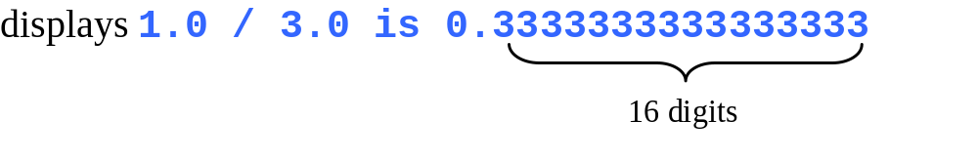
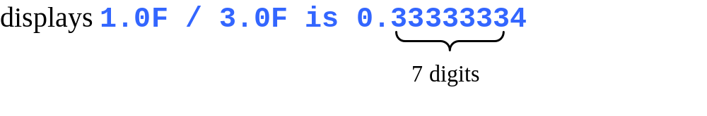
double vs. float
The double type values are more accurate than the float type values. For example,
System.out.println("1.0 / 3.0 is " + 1.0 / 3.0);
System.out.println("1.0F / 3.0F is " + 1.0F / 3.0F);

Slide 22

Arithmetic Expressions
is translated to
(3+4*x)/5 – 10*(y-5)*(a+b+c)/x + 9*(4/x + (9+x)/y)

Slide 23

How to Evaluate an Expression
Though Java has its own way to evaluate an expression behind the scene, the result of a Java expression and its corresponding arithmetic expression are the same. Therefore, you can safely apply the arithmetic rule for evaluating a Java expression.

